Slide 1
Divide-and-Conquer
Divide-and-conquer is probably the best-known general algorithm design technique.
A problem is divided into several subproblems of the same type, ideally of about equal size.
The subproblems are solved (typically recursively, though sometimes a different algorithm is employed, especially when subproblems become small enough).
If necessary, the solutions to the subproblems are combined to get a solution to the original problem.

Slide 2
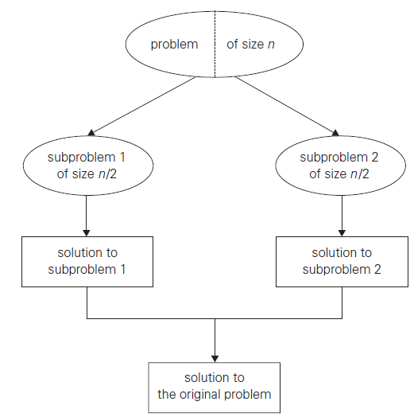
Divide-and-Conquer
Diagram depicts the case of dividing a problem into two smaller subproblems, by far the most widely occurring case (at least for divide-and-conquer algorithms designed to be executed on a single-processor computer).

Slide 3
Merge Sort
Merges ort is a perfect example of a successful application of the divide-and conquer technique.
It sorts a given array A[0..n − 1] by dividing it into two halves A[0..n/2 − 1] and A[n/2..n − 1], sorting each of them recursively, and then merging the two smaller sorted arrays into a single sorted one.

Slide 4
Merge Sort
ALGORITHM
//Sorts array A[0..n − 1] by recursive mergesort
//Input: An array A[0..n − 1] of orderable elements
//Output: Array A[0..n − 1] sorted in nondecreasing order
if n > 1
copy A[0..n/2 − 1] to B[0..n/2 − 1]
copy A[n/2..n − 1] to C[0..n/2 − 1]
Mergesort(B[0..n/2 − 1])
Mergesort(C[0..n/2 − 1])
Merge(B, C, A)

Slide 5
Merge Sort
EFFECIENCY
Assuming for simplicity that n is a power of 2, the recurrence relation for the number of key comparisons C(n) is
C(n) = 2C(n/2) + Cmerge(n) for n > 1, C(1) = 0.
At each step, exactly one comparison is made, after which the total number of elements in the two arrays still needing to be processed is reduced by 1.

Slide 6
Quicksort
Quicksort is the other important sorting algorithm that is based on the divide-and conquer approach.
Unlike merge sort, which divides its input elements according to their position in the array, quicksort divides them according to their value.

Slide 7
Quicksort
ALGORITHM
//Sorts a subarray by quicksort
//Input: Subarray of array A[0..n − 1], defined by its left and right
// indices l and r
//Output: Subarray A[l..r] sorted in nondecreasing order
if l < r
s ←Partition(A[l..r]) //s is a split position
Quicksort(A[l..s − 1])
Quicksort(A[s + 1..r])

Slide 8
Quicksort
EFFECIENCY
The number of key comparisons made before a partition is achieved is n + 1 if the scanning indices cross over and n if they coincide.
Cbest(n) = 2Cbest(n/2) + n for n > 1, Cbest(1) = 0.
If all the splits happen in the middle of corresponding subarrays, we will have the best case.
The number of key comparisons in the best case satisfies the recurrence.

Slide 9
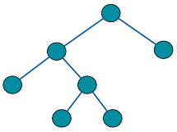
Binary Tree Traversals
We usually think of a binary tree as a special case of an ordered tree.
A binary tree T is defined as a finite set of nodes that is either empty or consists of a root and two disjoint binary trees TL and TR called, respectively, the left and right subtree of the root.

Slide 10
Binary Tree Traversals
ALGORITHM
//Computes recursively the height of a binary tree
//Input: A binary tree T
//Output: The height of T
if T = ∅ return −1
else return max{Height(Tlef t ), Height(Tright)} + 1

Slide 11
Binary Tree Traversals
We measure the problem’s instance size by the number of nodes n(T ) in a given binary tree T .
The number of comparisons made to compute the maximum of two numbers and the number of additions A(n(T )) made by the algorithm are the same.
We have the following recurrence relation for A(n(T )):
A(n(T )) = A(n(Tlef t)) + A(n(Tright)) + 1 for n(T ) > 0

Slide 12
Binary Tree Traversals
The most important divide-and-conquer algorithms for binary trees are the three classic traversals: preorder, inorder, and postorder. All three traversals visit nodes of a binary tree recursively, i.e., by visiting the tree’s root and its left and right subtrees.
In preorder traversal, the root is visited before the left and right subtrees are visited.
In inorder traversal, the root is visited after visiting its left subtree but before visiting the right subtree.
In postorder traversal, the root is visited after visiting the left and right subtrees.

Slide 13
Strassen’s Matrix Multiplication
The Strassen algorithm, named after Volker Strassen, is an algorithm for matrix multiplication.
It is faster than the standard matrix multiplication algorithm and is useful in practice for large matrices.
Strassen’s algorithm is a Divide-and-Conquer algorithm that is asymptotically faster, i.e. O ( nlog 7).

Slide 14
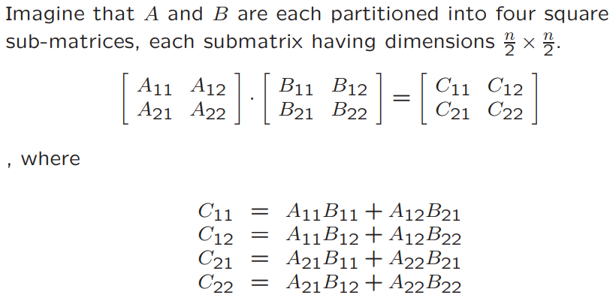
Strassen’s Matrix Multiplication

Slide 15
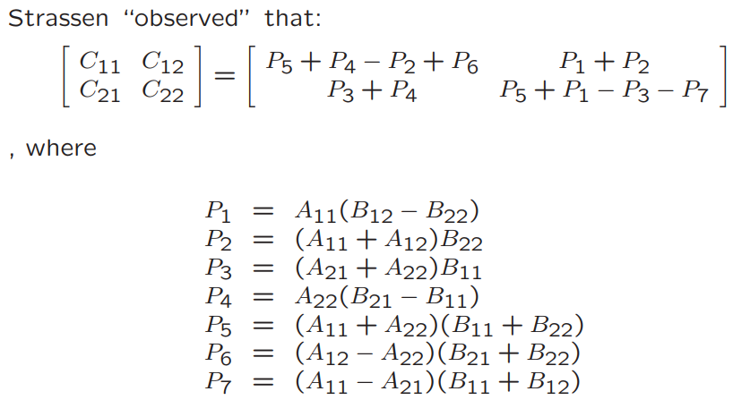
Strassen’s Matrix Multiplication

Slide 16
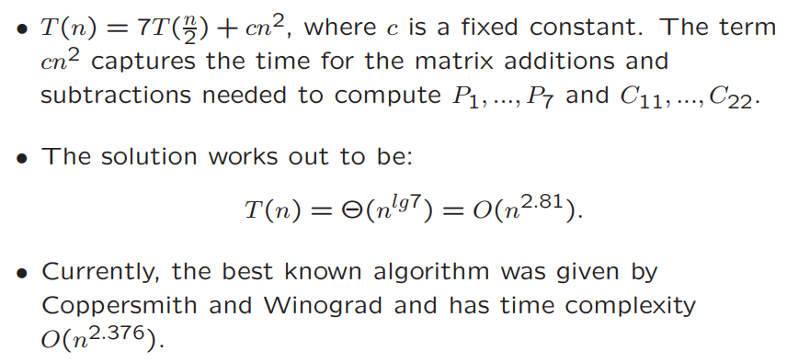
Strassen’s Matrix Multiplication

Slide 17
Closest-Pair
ALGORITHM EfficientClosestPair(P, Q)
//Input: An array P of n ≥ 2 points in the Cartesian plane sorted in nondecreasing order of their x coordinates and an array Q of the same points sorted in nondecreasing order of the y coordinates
//Output: Euclidean distance between the closest pair of points
if n ≤ 3
return the minimal distance found by the brute-force algorithm
else
copy the first n/2 points of P to array Pl
copy the same n/2 points from Q to array Ql
copy the remaining n/2 points of P to array Pr
copy the same n/2 points from Q to array Qr
dl ←EfficientClosestPair(Pl, Ql)

Slide 18
Closest-Pair
dr ←EfficientClosestPair(Pr, Qr)
d ←min{dl, dr }
m←P[n/2 − 1].x
copy all the points of Q for which |x − m| < d into array S[0..num − 1]
dminsq ←d2
for i ←0 to num − 2 do
k←i + 1
while k ≤ num − 1 and (S[k].y − S[i].y)2 < dminsq
dminsq ←min((S[k].x − S[i].x)2+ (S[k].y − S[i].y)2, dminsq)
k←k + 1
return sqrt(dminsq)

Slide 19
Closest-Pair
The algorithm spends linear time both for dividing the problem into two problems half the size and combining the obtained solutions.
Therefore, assuming as usual that n is a power of 2, we have the following recurrence for the running time of the algorithm.
T (n) = 2T (n/2) + f (n).

